Slide 1
Towards Summarization Metrics
Forest Pearson, Shreyoshi Mahato, Shatabdi Pal, Ehsan Moghaddam
Notes:
Ehsan

Slide 2
Presentation Content
Background Information - Ehsan
Motivation for the subject - Ehsan
Related Issues - Shreyoshi
Prior Work - Forest
Our Work - Ehsan
data - Shatabdi
Results - Shatabdi
Conclusions - Shatabdi
Notes:
Ehsan

Slide 3
Summarization Evaluation
There are two mainstream ways for summarization evaluation:
1) Human based evaluation
2) Automatic metrics
Evaluation is a major step for progressing in summarization research
In summarization field a to go metric seems to be missing (Alexander et al 2021)
Human based evaluation is expensive and prone to subjectivity errors.
Notes:
Ehsan

Slide 4
Motivation for Automatic metrics
Automatic metrics for summarization can help to
Speed up progression in this field
Reduce than the evaluation cost
Compare different summirzation models
Notes:
Ehsan

Slide 5
Evaluation Metrics
SummEval: Ensemble of different metrics and different methods
Rouge: ROUGE measures the overlap between the generated summary and a set of reference summaries
BertScore: computes similarity scores by aligning generated and reference summaries on a token-level.
Notes:
Ehsan

Slide 6
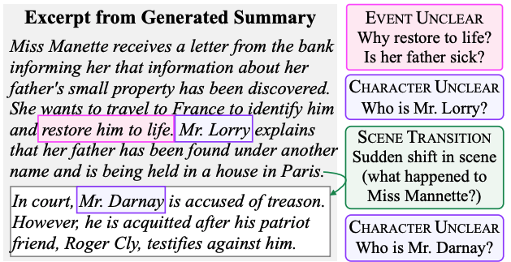
Generated long book summaries cover the important information, but they read like a list of events stapled together without any coherent narrative structure
- Wu et al.(2021)
Notes:
Shreyoshi
I will be discussing some of the issues related to long generated summaries.
So, here is a short example of a generated book summary by OpenAI model
So here it goes … READ THE SUMMARY
The event “restore him to life” is unclear. There is a missing reference, so we don’t know at this point why she wants to restore her father to life. Is he sick?
Continuing from there …
But who is Mr. Lorry this new character is not introduced yet.
READ AGAIN…
Again who is Mr Darnay, he is also not introduced and has no reference in previous text. Also there is a drastic change in the scene which is strange.
From Mr Lorry explaining Miss Manette to Mr Darnay being accused in a court. What happened in between? The individual segments do not follow a coherent structure and extra information is needed to understand the narrative.
So they appear as a list of events stapled together without any coherent narrative structure.
NEXT SLIDE please…

Slide 7
Issues
Now that models are so good at generating fluent and on-topic sentences, the coherence of the whole summary becomes a first-order issue that must be evaluated.
Current automatic and human evaluation methods fail to identify gaps in coherence. Lack of evaluation framework for long summaries
Human evaluation is rarely done for longer summaries due to the associated labor costs of reading and evaluating long text.
Notes:
Shreyoshi
These are some of the issues that needs our attention :
With recent advancements in language models generating highly fluent and on-topic sentences is not an issue but evaluating the overall coherence of a summary has become a crucial factor that must be addressed.
But current automated metrics are not perfect in evaluating long summaries. They are inadequate at identifying gaps in coherence.
Additionally, human evaluation of longer summaries is rare due to the labor-intensive nature of reading and evaluating lengthy text which makes them costly and time taking.
NEXT SLIDE please…

Slide 8
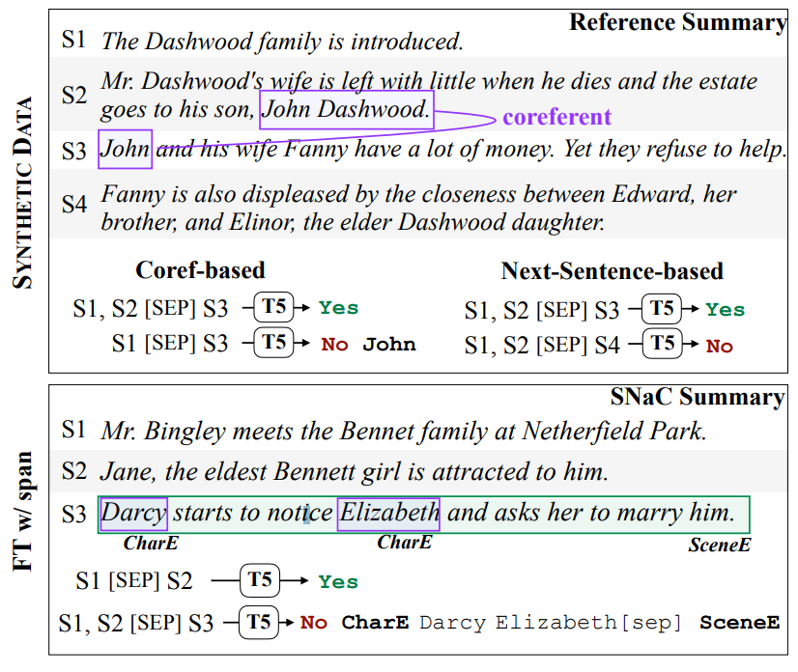
Paper Key Ideas
Longform text is inhibited by a lack of evaluation
Presents a narrative coherence evaluation framework
Develop a taxonomy of coherence errors
Showcase collected annotation use
Notes:
Forest

Slide 9
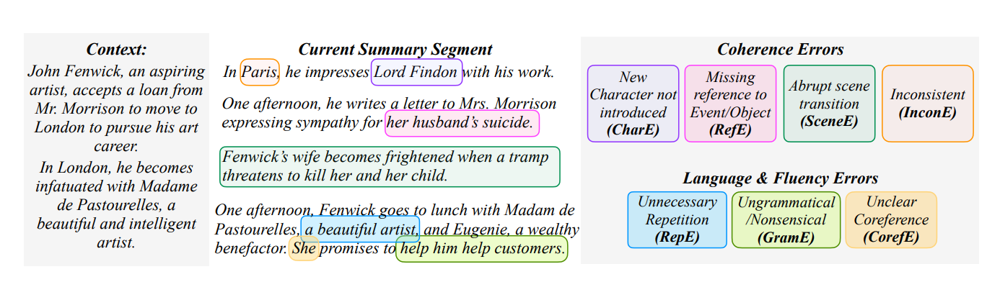
How it works
Collect Context
Identify span errors
Ensure the summary doesn’t read like a list
Suggest the type of error present
Notes:
Forest

Slide 10
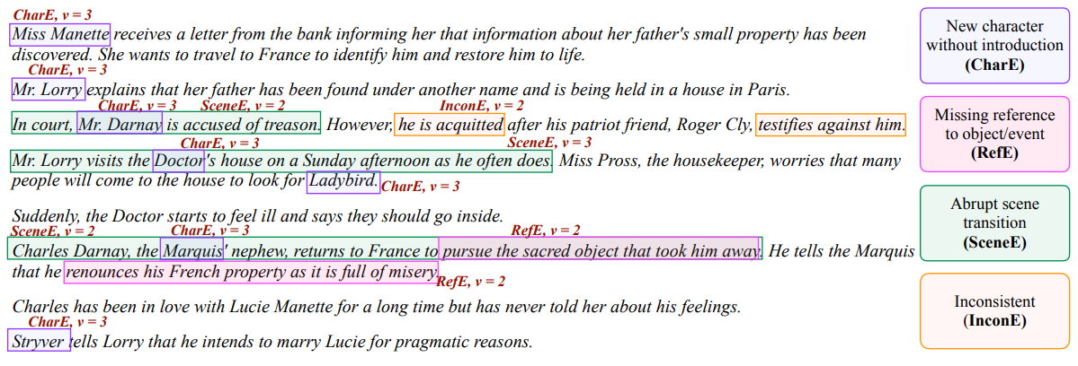
Notes:
Forest

Slide 11
Coherency & Language Errors
Character without introduction (CharE)
Missing reference to an event (RefE)
Abrupt scene transition (SceneE)
Inconsistency(InconE)
Repetition (RepE)
Ungrammatical Text (GramE)
Unclear reference (CorefE)
Notes:
Forest

Slide 12
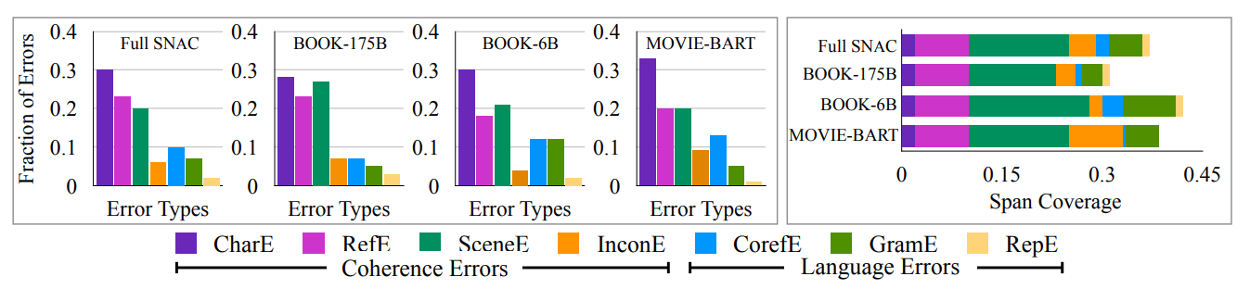
Human Annotation Training
Expert Annotations, high agreement
Crowd Annotations, some inconsistency
Results in a dataset of ~9.6k span-level annotations
Notes:
Forest

Slide 13
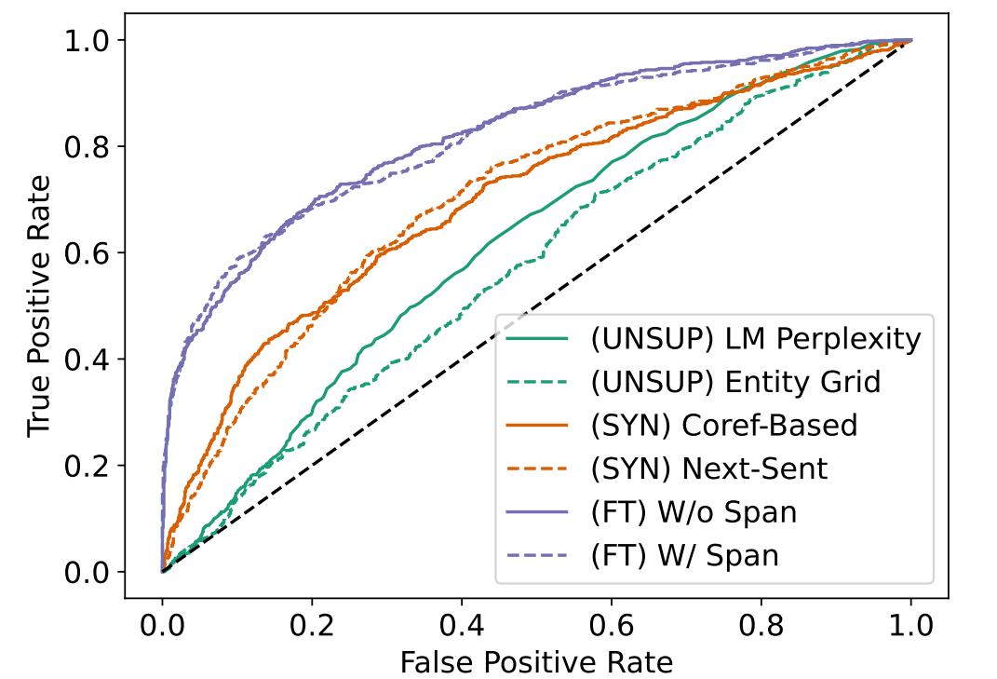
Error Detection Comparison
Tests several models against two based on SNaC data
ROC curve of different models
Shows the need for human annotations in training
Only SNaC can predict error category
Notes:
Forest

Slide 14
Paper analysis
Current narrative summarizers show issues
Automatic evaluation can’t bridge the gap
Not a prepackaged metric yet
Fine-grained error detection can be beneficial
A focus on span coherence has benefits
Notes:
Forest

Slide 15
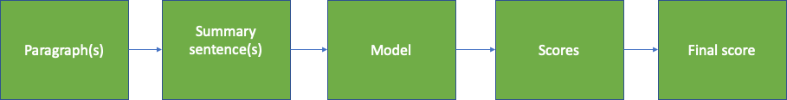

Our work - A Summary Scoring System
Notes:
Ehsan

Slide 16
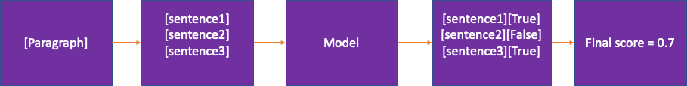
Summary Scoring System - Example
Notes:
Ehsan

Slide 17
Our DataSet
Test sample summarization created by using ChatGPT, Facebook bart large model , T5-Base model, online summarizer
ChatGPT for creating summary of 3 Ebooks
Facebook bart large model for research article, review article
T5-base for blog article on BERT
Codelink:
https://colab.research.google.com/drive/1MElK6evfIZRqMnPi9eGTYZ_EMMl3nyC8#scrollTo=xPqB-g7Q3F9E
https://colab.research.google.com/drive/1Ymnufn58nN_WVpWPh8ZvAztHdqIH_7DI
Notes:
Shatabdi

Slide 18
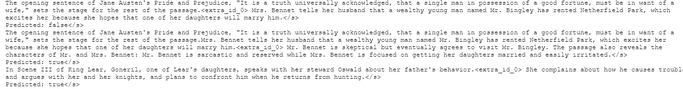
Generating Results
Output of span model
Output of no span model
Notes:
Shatabdi

Slide 19
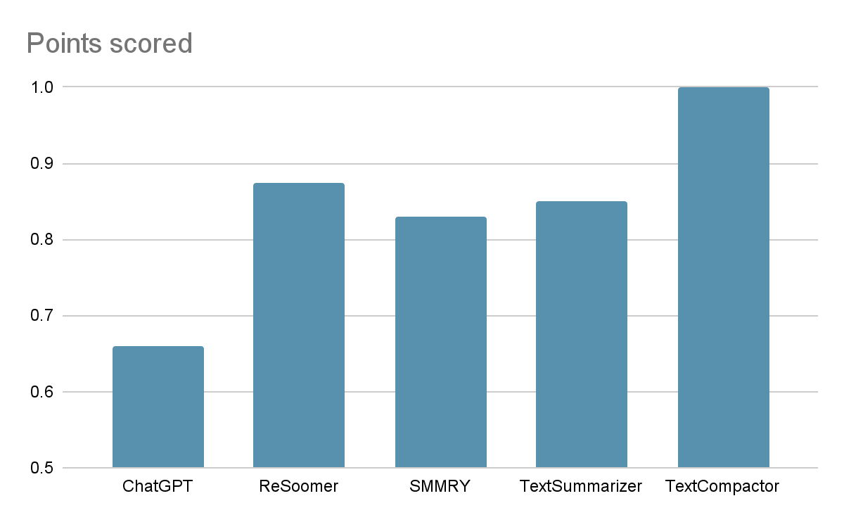
Results
Processed the same text
Pre-processed for the software into 5-8 sentences
Tested on five popular summarizers
Abrupt scene transitions and character introductions were common
Notes:
Shatabdi
All used the same chapter of the Jane Austin Text Pride and Prejudice.
Tested on popular summarizers found by searching online.
Ideally was summarized into 5-8 sentences, although wasn’t always given the option to specify.
Pre-processed into TSV format with context-sentence format
Surprisingly in this case GPT performed worst with 2 abrupt scene transitions, the rest of the summarizers mostly showed non-introduced character errors.

Slide 20
Conclusion
Existing model fails to generate coherent narrative
BELU, METEOR, ROUGE, BERTScore fails to evaluate coherence of summarization
Human fails to evaluate summary generated by GPT-3 model
SNac, a narrative coherence evaluation framework for long summaries.
SNAC model can detect span-level coherence error
SNAC achieve high accuracy on CharE error
This model is limited to English language only
SNac is trained on books summary and movie script. It model is not free from societal biases.
Multi document text summarization can be applied to verify the performance of the model
Notes:
Shatabdi

Slide 21
References
SummEval: Re-evaluating Summarization Evaluation (https://arxiv.org/abs/2007.12626)
https://www.freeclassicebooks.com/jane_austen.htm
https://www.freeclassicebooks.com/william_shakespeare.htm
https://www.researchgate.net/publication/277411157_Deep_Learning
https://arxiv.org/abs/2205.09641
http://jalammar.github.io/illustrated-bert/
https://analyticsindiamag.com/here-are-top-five-text-summarization-tools-that-could-be-helpful/

Slide 22
Thank you

